Slide 1



Slide 2

PLANNING, DESIGN & IMPLEMENTATION
Definitions:
Planning: Planning is the process of thinking about the activities required to achieve a desired goal. Planning is based on foresight and, in humans at least, on the fundamental capacity for mental time travel.
Project planning: This is the process of documenting steps for accomplishing a goal within a certain time frame
Design: This is a plan or drawing produced to show the look and function or workings of a building, equipment, or other object before it is made
Implementation: The process of putting a decision or plan into effect; execution.

Slide 3
PROCESS FOR FTTH NETWORK PLANNING
Preliminary Studies.
Providing a first assessment and preliminary business-plan of an optical fiber network deployment project.
Build a business plan in preparation of internal budgets or for submission to financial institutions.
Assess the relative attractiveness and economic value of some areas compared to others.
Quickly determine the zoning of deployment and location of the main elements of the network.
High-level network planning
High-level studies aims to give the most accurate estimate to build the network without incurring significant costs particularly with regards to data collection on field. The objective is to:
Integrate existing infrastructure (pipes, ducts, etc.).
Specify engineering rules to be used.
Use more precise geographic data and more accurate costing information.
Detailed network planning
The detailed network planning studies are the final step before the construction phase of the network. In this type of study, the highest possible precision before the civil works starts should be achieved. Detailed engineering studies aim at:
Finalizing the network topology.
Producing complete detailed quantitative requirements (cables, cabinets, bill of quantities, etc.).
Incorporating all specific constraints in relation with the area to be deployed.

Slide 4

SURVEY
Survey is defined as the act of examining a process or questioning a selected sample of individuals to obtain data about a service, product, or process
examine and record the area and features of (an area of land) so as to construct a map, plan, or description.

Slide 5
Types of Survey
Online surveys: One of the most popular types is an online survey. ...
Paper surveys: As the name suggests, this survey uses the traditional paper and pencil approach. ...
Telephonic Surveys: Researchers conduct these over telephones. ...
One-to-One interviews: ...
Cross-sectional studies

Slide 6
FTTH SURVEY TOOLS
Map: A map is a symbolic representation of selected characteristics of a place, usually drawn on a flat surface. Maps present information about the world in a simple, visual way. They teach about the world by showing sizes and shapes of countries, locations of features, and distances between places.
GPS: The Global Positioning System (GPS) is a space-based satellite navigation system that provides location and time information in all weather condition.
Measuring wheels: Measuring wheels have a counting mechanism that counts the number of rotations and uses the circumference of the wheel to calculate the distance covered. It is also known as a surveyor's wheel, click wheel, odometer, or trundle wheel.
Jotter and pencil

Slide 7



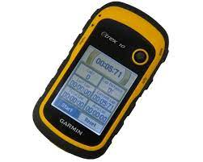

Slide 8

DESIGN
Design is a plan or drawing produced to show the look and function or workings of a building, equipment, or other object before it is made
FTTH DESIGN: a collective term used to describe a wide range of broadband network architecture options utilizing optical fiber for some or all of their last mile connectivity.

Slide 9
DESIGN TOOLS AND DOCUMENTATION
Google Erath
Google Map
AutoCAD
Visio
MS Excel
MS Words
QGIS
OSPInsight
Softelnet

Slide 10
Architecture Design of FTTH Network
Architecture of GPON FTTH Network: An FTTH access network comprises five areas, which are a core network area, a central office area, a feeder area, a distribution area and a user area/customer premises.

Slide 11
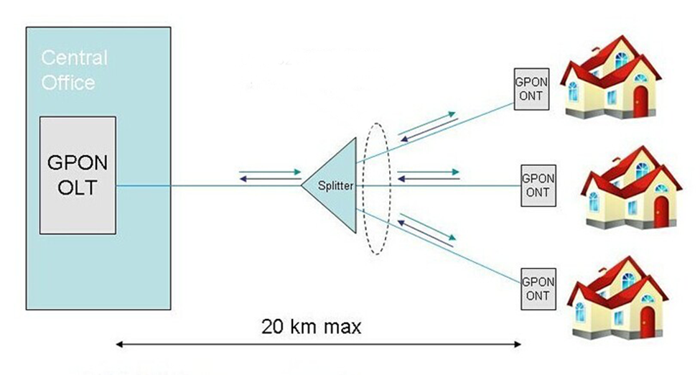
GPON TECHNOLOGY
GPON stands for Gigabit Passive Optical Networks. A GPON network includes shared network equipment in the central office (OLT) and a dedicated optical unit at each subscriber location (ONU/ONT).

Slide 12
FTTH PLANNING
NEXT

Slide 13
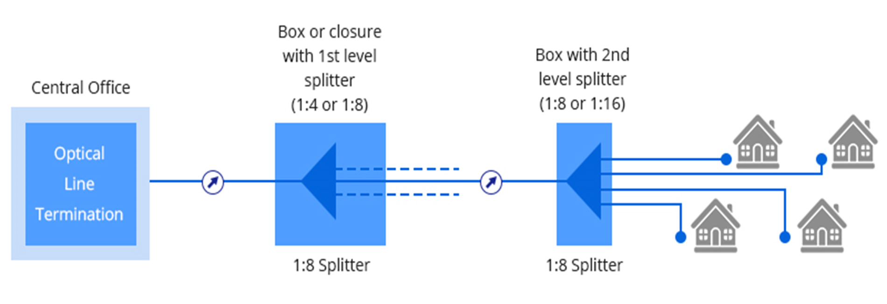
NETWORK DESIGN TOPOLOGY

Slide 14
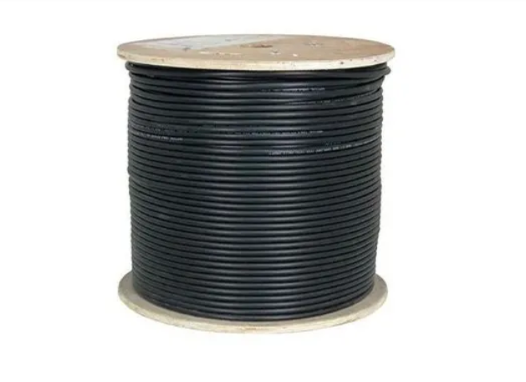

TYPES OF FIBER OPTIC CABLE
OUTDOOR CABLE
INDOOR CABLE

Slide 15

CABLES

Slide 16
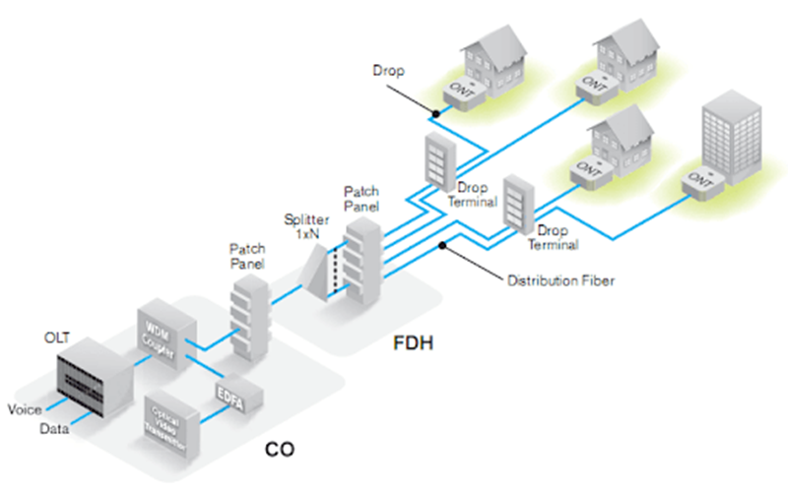
ACHITECTURAL DESIGN OF FTTH

Slide 17
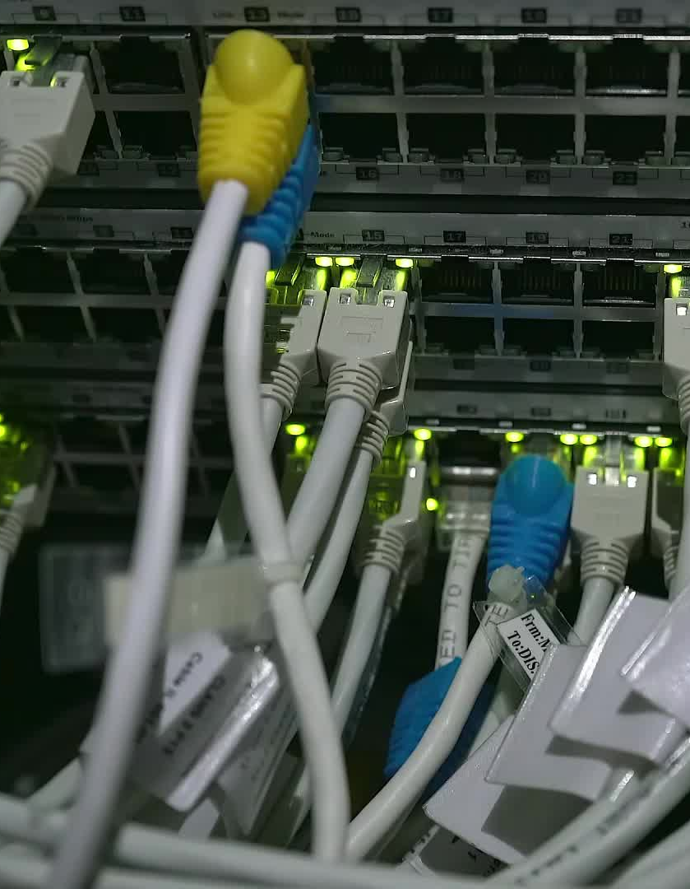
OUTSIDE PLANT
A passive optical network is a fiber-optic telecommunications technology for delivering broadband network access to end-customers .
A GPON network is capable of transmitting multiplexing divided by time (TDM), Ethernet, and ATP traffic. These type of networks consists of an OLT (Optical Line Terminals) unit, an ONU (Optical Network Unit) and a splitter (Splitter). The splitter will redirect the signal when necessary. The OLT unit takes all the optical signals in the form of light beams from the ONUs and converts them into electrical signals. OLTs typically support up to 72 ports. An ONU connects end users and forwards the signal back to the OLTs. A GPON Network supports a physical distance of up to 20 kilometers and can provide service to 64 end users. GPON uses upstream and downstream data using Optical Wavelength Division Multiplexing (WDM).
Protocol level security: Basic Encryption
Downstream speed: 2.4 Gbps
Upstream speed: 1.2 Gbps
Logic maximum distance: 60 km
Physical Maximum distance: 20 km

Slide 18
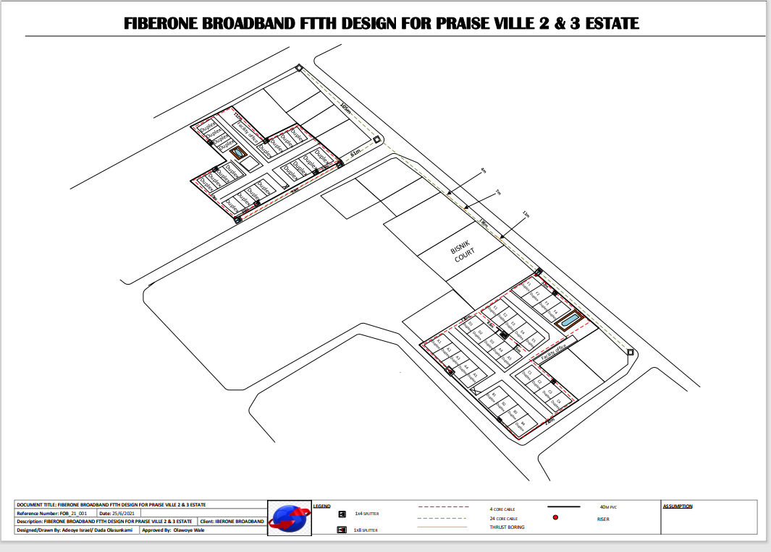
SAMPLE OF DESIGN

Slide 19

GPON EQUIPMENTS

Slide 20
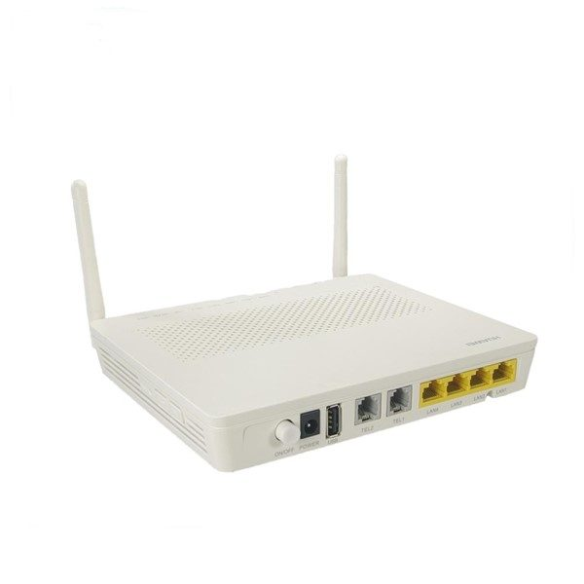
ONU / ONT

Slide 21
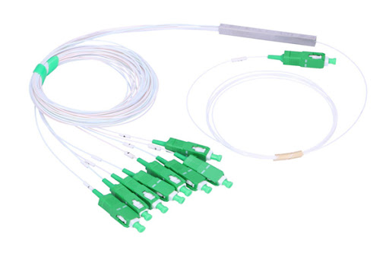
SPLITTER

Slide 22
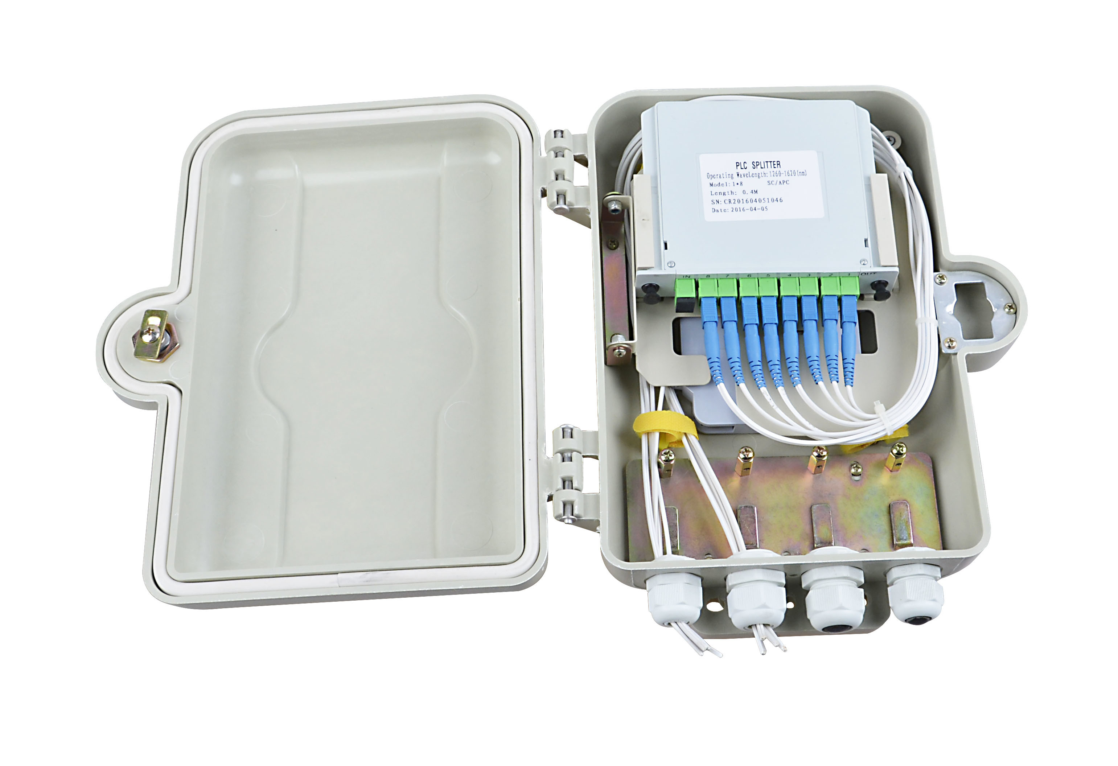
AND SPLITTER BOX

Slide 23
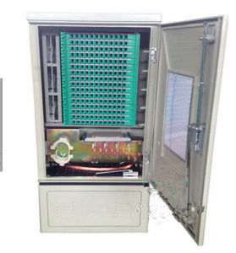
CABINET

Slide 24
END
THANK YOU

